Slide 1
Lecture 1
Basic Theory of Model Predictive Control (MPC)

Slide 2
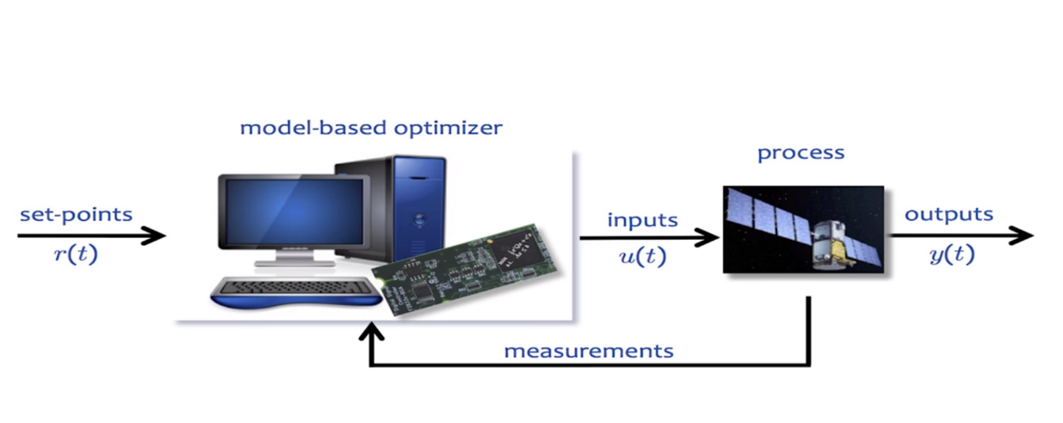
Motivation
Control of autonomous car: PID vs MPC
Trajectory optimization of autonomous drone: ETHZ

Slide 3
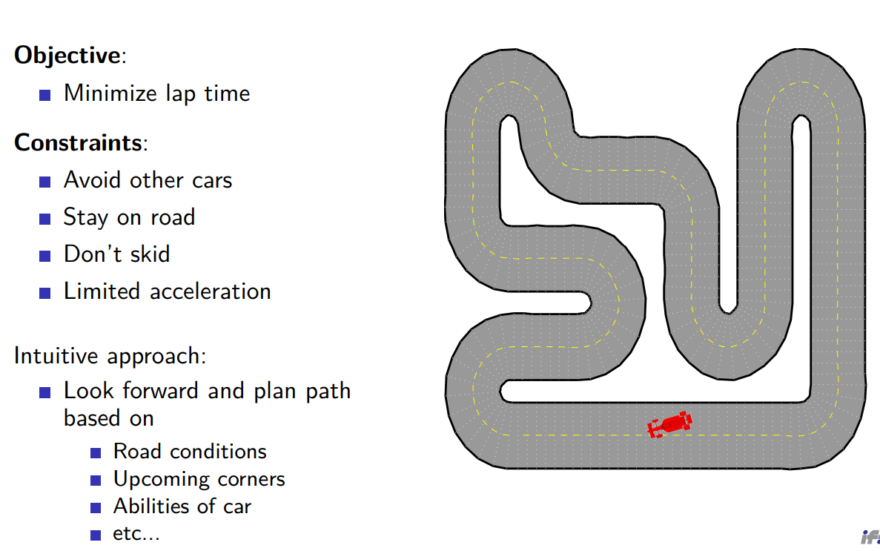
Idea

Slide 4
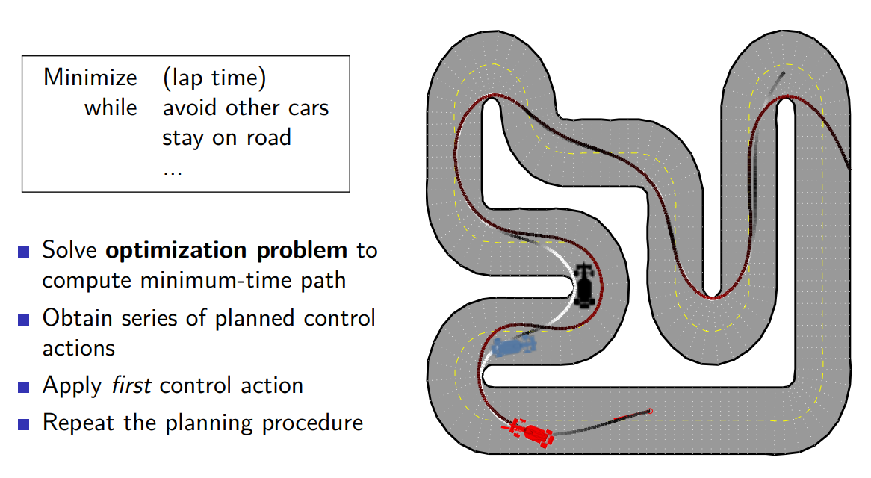
Optimization-Based Control

Slide 5
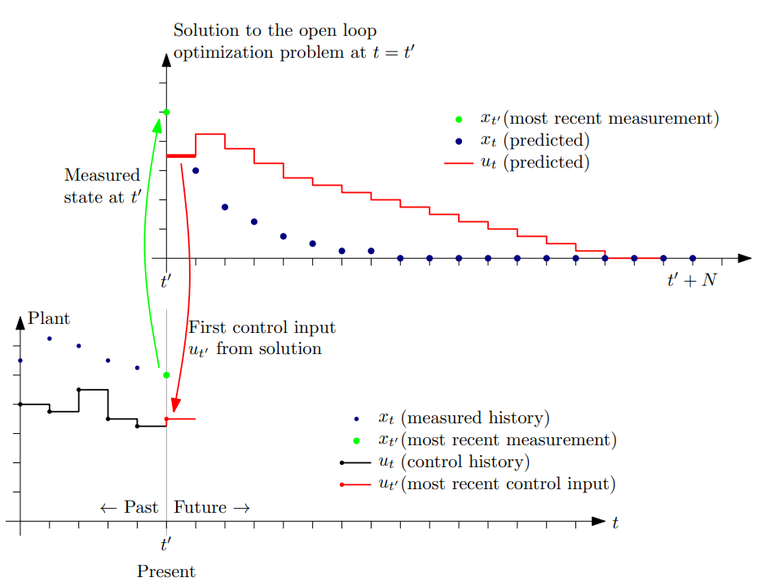
Principle of MPC

Slide 6
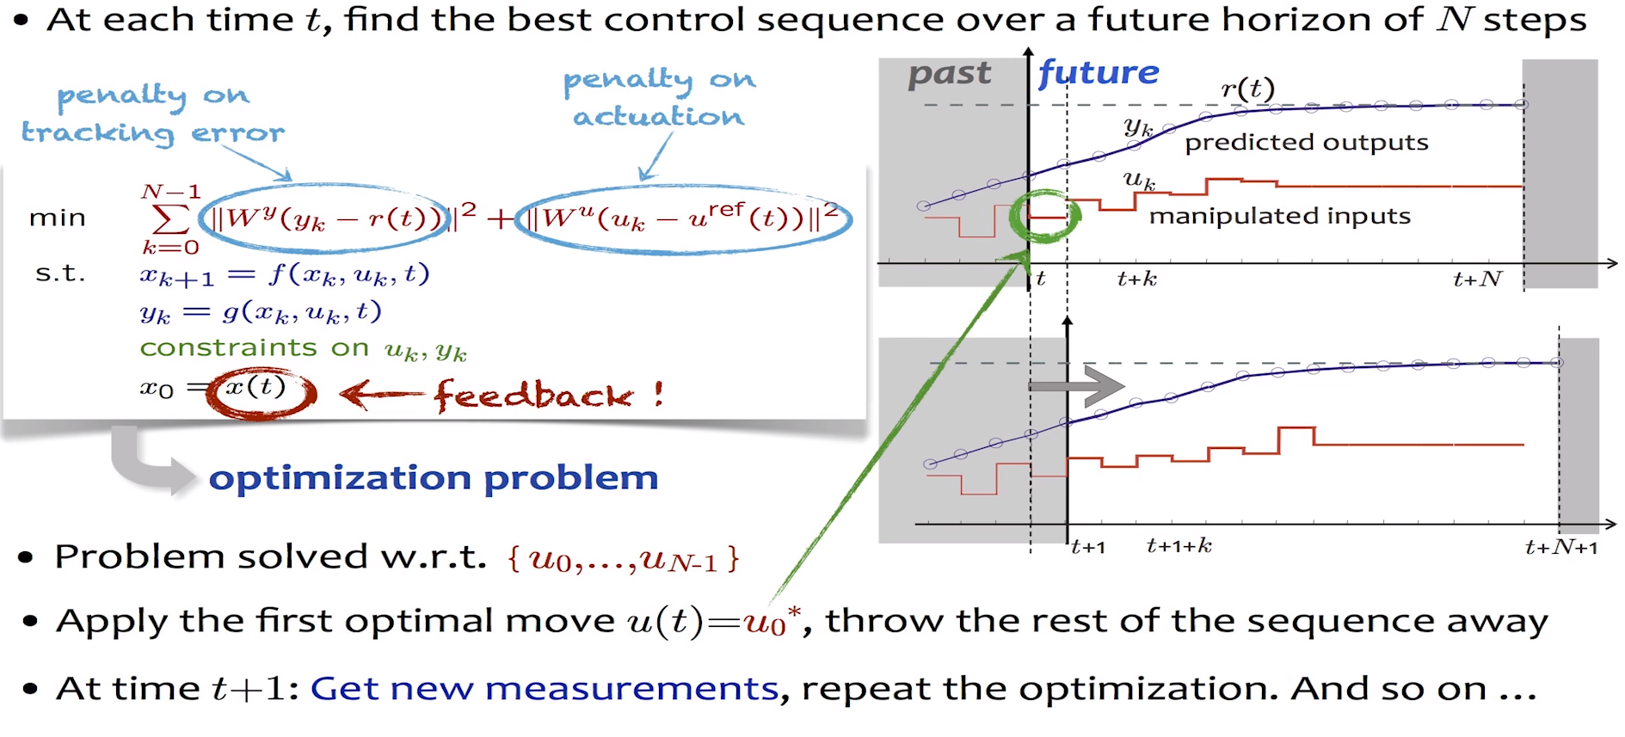

Slide 7
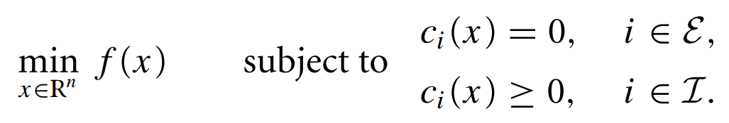
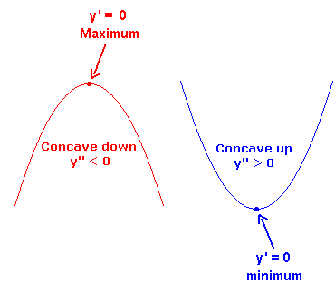
General form of Optimization

Slide 8
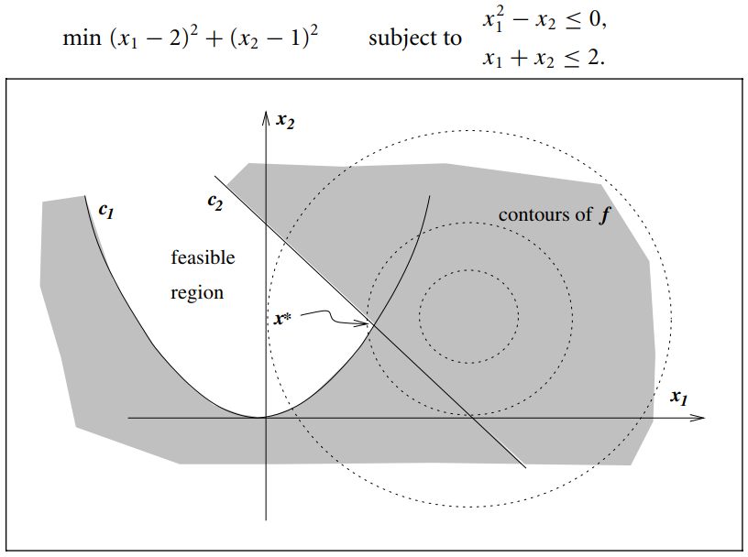
Feasible region

Slide 9
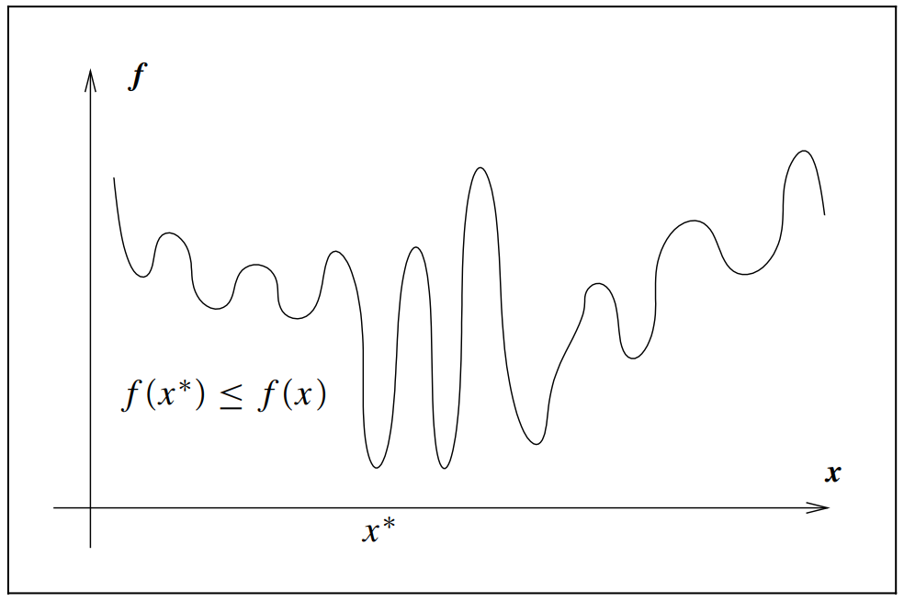
Unconstrained optimization
What is a solution?

Slide 10
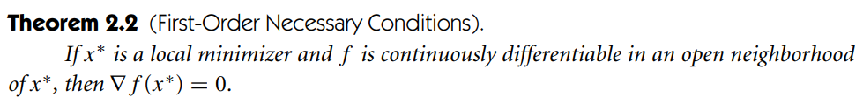
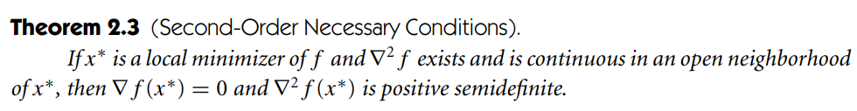
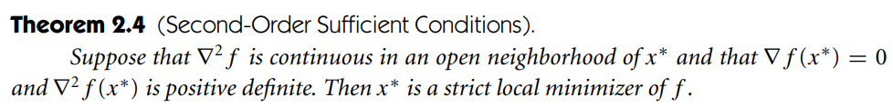
Necessary and sufficient conditions

Slide 11
Matlab solvers
Linear Programming (linprog)
Quadratic Programming (quadprog)
Nonlinear Programming (fmincon)

Slide 12
Example
A store has requested a manufacturer to produce pants and sports jackets. For materials, the manufacturer has 750 m² of cotton textile and 1,000 m² of polyester. Every pair of pants (1 unit) needs 1 m² of cotton and 2 m² of polyester. Every jacket needs 1.5 m² of cotton and 1 m² of polyester. The price of the pants is fixed at 50 and the jacket 40.
What is the number of pants and jackets that the manufacturer must give to the stores so that these items obtain a maximum sale?

